Slide 1
Chapter 4

Slide 2
The Strategic Management Process
External
Analysis
Strategic
Choice
Strategy
Implementation
Competitive
Advantage
Mission
Objectives
Internal
Analysis
Business Level
Strategy
Corporate Level
Strategy
The actions that firms take to gain competitive advantage in a single market or industry
Notes:
strategic choices can be categorized as business level strategy issues and corporate level strategy issues.
business level strategic choices are concerned with the positioning of specific businesses

Slide 3


There are 2 generic types of business level strategy…
Cost Leadership: focuses on gaining advantages by reducing firm costs below competitors
Product Differentiation
Notes:
Two generic business level strategies are cost leadership and differentiation.
Cost leadership
generate economic value by having lower costs than competitors
Product differentiation
generate economic value by offering a product that customers prefer over competitors’ product
This chapter covers cost leadership and the next chapter will cover product differentiation.

Slide 4
Why Cost Leadership Matters
Competitive Market
ATC_{ind}
ATC_{ff}
P
D
Above Normal
Economic
Returns
Q
Notes:
Cost leadership matters because it will allow the focal firm to have average total costs (ATC) that are less than the industry average total costs (ATCind).
Thus, an above normal return is possible.
Two important things to note:
1-The focal firm does not have to charge a lower price—it can enjoy a wider margin than competitors. (i.e. to be a cost leader a firm doesn’t have to sell at the lowest price)
2 -If other firms have higher cost (such as the industry average total cost) they can never win a price war with the cost leader (firms in a market with a cost leader have strong incentive not to compete on the basis of price).
3- Rather firms have a strong incentive to compete on cost (not price) because of the advantages explained above.
Therefore, firms enjoying cost advantages typically face strong competitive pressures on their cost positions.

Slide 5
Understanding Cost Advantage
Managers need to understand who has
the cost advantage in their market
Notes:
it could be the focal firm
If so, managers would probably develop a strategy to exploit the advantage
it could be a competitor
If so, managers would try to develop a strategy to either capture the advantage or compete on some other basis
In sum, finding out that the focal firm is not likely to have a cost advantage may be just as valuable as finding out that the focal firm is likely to have a cost advantage.

Slide 6
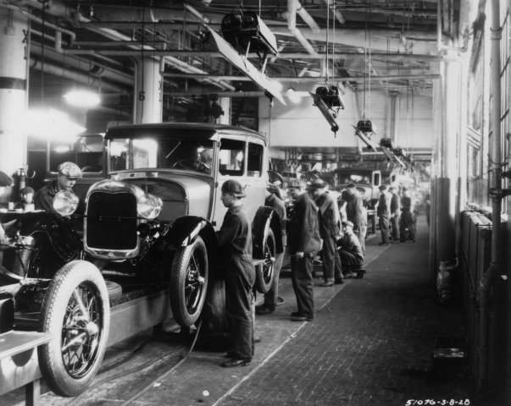

Sources of Cost Advantage
Economies of Scale
Notes:
average cost per unit falls as quantity increases-until the minimum efficient scale is reached
are a cost advantage because competitors may not be able to match the scale because of capital requirements or insufficient demand

Slide 7
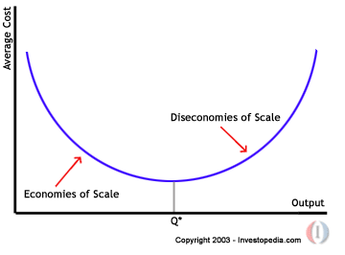

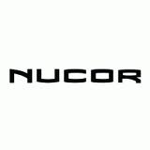
Sources of Cost Advantage
Competitor Diseconomies of Scale
Notes:
are an advantage for those who do not have diseconomies of scale
occur when firms production moves beyond the minimum efficient scale—average per unit cost increases as quantity produced increases
physical diminishing returns to scale—machines that handle larger volumes may be prone to more defective pieces and/or may be so expensive as to result in higher average per unit costs
transportation costs—trying to cover a vast geographic area from a very large plant may contribute to diseconomies of scale
human factors—overly bureaucratic, de-motivated
Nucor Steel had several cost advantages, one of which was the fact that the large integrated mills were experiencing diseconomies of scale in the parts of the market that Nucor served (light structural steel, rebar, etc.).

Slide 8
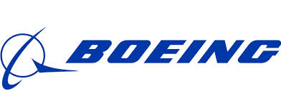
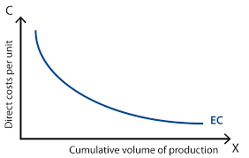
Sources of Cost Advantage
Learning Curve Economies
Notes:
a firm gets more efficient at a process with experience
the more complicated/technical the process, the greater the experience advantage
Example: GM, Bosch and fuel injectors
General Motors used to license technology from Robert Bosch, a German company, to produce fuel injectors rather than purchase them from Bosch like their competitors did.
The basic terms of the agreement were that Bosch would share new technology within six months of any such new technology being put into production.
As a result of this agreement GM was always behind Bosch in both quality and cost because Bosch was essentially guaranteed a learning curve advantage.
Eventually the GM exited the fuel injector business and purchased many of its fuel injectors from Bosch.

Slide 9


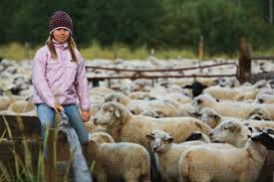
Sources of Cost Advantage
Differential Low-Cost Access to Productive Inputs
Notes:
Occurs when firms are able to access inputs at less cost than competitors
may result from:
history—being in the right place at the right time
being first into a market—esp. foreign markets
natural endowment—owning a mineral deposit
locking up a source—buying in bulk all of its output

Slide 10
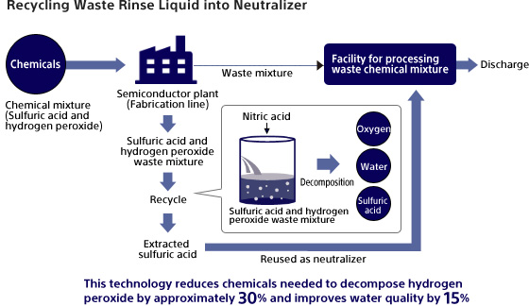

Sources of Cost Advantage
Technology Independent of Scale
Notes:
Occurs when a technology allows a firm to produce something at a lower cost than its competitors
The cost advantage that a technology might create typically accrues to the ‘owner’ of the technology—may or may not be the ones who actually use the technology
Example: Sony Semiconductor
The cleaning process during semiconductor fabrication processes frequently uses a mixture of sulfuric acid and hydrogen peroxide. The waste mixture resulting from cleaning is treated with large amounts of water and other chemicals, generating large volumes of sludge and wastewater. Sony discovered that by adding a trace of nitric acid, the residue of hydrogen peroxide in the waste mixture decomposed into oxygen and water effectively. Using this phenomena Sony developed a technology to extract highly concentrated sulfuric acid containing no hydrogen peroxide from the waste mixture. Sony Semiconductor Corporation has been using this technology at its plant since 2001, and the extracted concentrated sulfuric acid is being put to good use as a neutralizer for wastewater treatment within the plant. Because it does not require forced heating or cooling, this process also helps reduce the amount of energy consumed by recycling equipment.

Slide 11


Sources of Cost Advantage
Policy Choices
Notes:
firms get to choose how they will serve the market
Firm’s can offer level of quality that is inexpensive to produce
Firms can make policy choices that give people incentives to reduce cost at every opportunity
Example: Southwest
Standardized fleet
Focus on short, fuel efficient routes
Southwest Airlines adopted human resource policies that have contributed to their cost advantage (cross functional work practices, hiring practices, incentive systems, etc.)
Other large airlines cannot effectively make these policy choices at this point in time because of unions, traditional, psychological contracts, etc.
Thus, Southwest’s policy choices are a source of cost advantage.
Example: Jet Blue
Cut a row out of their planes to reduce weight and reduce the number of flight attendants required by the FAA

Slide 12
Cost Leadership & Competitive Advantage
A source of cost advantage will lead to sustainable
competitive advantage if that source is:
• Valuable
• Rare
• Costly to Imitate
• Organized (Implemented Appropriately)
Notes:
So say that we determine that a firm indeed has a cost advantage – How can we tell if that cost advantage will lead to a competitive advantage?

Slide 13
Value of a Cost Advantage: Env. Threats
New Comp.
Buyers
Existing Comp.
• competitors rationally
avoid price competition
Substitutes
Suppliers
Notes:
A single source of cost advantage may be valuable for multiple reasons (i.e., it neutralizes more than one threat).
The more threats that are neutralized by the cost advantages a firm possesses, the more value they will create.
Entry: Creates cost-based barriers to entry (econ of scale, cost adv indep of scale, etc.)
Buyers: Can accommodate the demands of powerful buyers and still have above average performance; deters backward integration; econs of scale limit buy options
Suppliers: Can accommodate the higher supplier prices and still earn above average performance; econ of scale limit supplier options
Substitutes: Can keep their prices low, reducing the attractiveness of substitutes
Rivalry: higher cost competitors won’t engage in price wars because they’ll lose.

Slide 14
Value of a Cost Advantage: 6 Segs. of GEE
Technological
Change
Specific
International
Events
Technology Diffusion to Emerging Markets
Demographic
Trends
European Union Ban on
Hormone-Treated U.S. Beef
Suburbanization of population
Focal
Firm
Changing Policy toward Oil
Exploration on Public Lands
Poor Image of Big Business
‘Crappy’
Economy
Legal/Political
Conditions
Cultural
Trends
Economic
Climate
Notes:
Not in the textbook, but somewhat useful for the Wal-mart in China case.

Slide 15
Rareness of a Cost Advantage
The rareness of a source of cost advantage
depends heavily on the industry life cycle:
Generally…
Emerging
Mature
Economies of Scale
Not Rare
Rare
Diseconomies of Scale
Rare
Rare
Learning Curve Economies
Rare
Not Rare
Differential Input Access
Rare
Rare
Technology
Rare
Not Rare
Policy Choices
Rare
Rare
Notes:
Economies of Scale:
• are less likely to be rare in emerging industries because multiple firms are discovering where the minimum efficient scale is
• may become more rare as the industry matures if the minimum efficient scale is discovered to be quite large and if industry demand roughly equals industry capacity—such that an incremental plant at minimum efficient scale would vastly exceed industry demand—this is even more likely as an industry declines
Diseconomies of Scale:
• are likely to be rare in emerging and mature industries because most firms will not exceed the minimum efficient scale
• may become less rare in a declining industry if demand falls sharply leaving most firms with excess capacity—this is not a likely scenario
(Remember diseconomies of scale refer to other firms, not the focal firm)
Learning Curve Economies:
• are likely to be rare in an emerging industry because the first-mover is moving along the learning curve ahead of competitors
• are likely to become less rare as the industry matures as competitors also move along the learning curve—as the learning curve flattens the advantage of more cumulative experience lessens
Differential Low-Cost Access to Inputs:
• may be rare in emerging industries if the inputs themselves are rare, such as mineral deposits or input factor markets that are of limited size, otherwise there is not likely to differential low-cost access
• may arise (and be rare by definition) as the industry matures if a firm is able to tie-up sources of supply by acquiring suppliers or forming exclusivity agreements with suppliers
Technology Advantages:
• are likely to be rare in emerging industries as the new technologies are developed
• usually become less rare over time as duplication occurs or as competitors are able to buy the same technology—some technology can remain rare if the firm is able to protect its proprietary nature, especially software technology as opposed to hardware technology
Policy Choices:
• valuable policies may be rare in emerging industries as many different firms establish various policies—some firms will adopt policies that prove to be valuable and others will adopt policies that prove to have little, if any, value
• some valuable policy choices will remain rare if those policies are 1) difficult to observe and/or understand, or 2) if the adoption of those policies is costly for competitors because of path dependency—other airlines face a large cost disadvantage in attempting to adopt some of Southwest Airlines’ human resource policies

Slide 16
Imitability of Sources of Cost Advantage
Different conditions determine if a source of cost
advantage will be costly to imitate
Low Cost Conditions
Unbalanced Industry Capacity and Demand
Non-Proprietary Technology
Highly Observable Technology
Transactional Exchange
Notes:
Unbalanced Industry Capacity and Demand
• when an industry has excess demand, economies of scale advantages are imitated at relatively low cost because competitors have an incentive to expand capacity
• when an industry has excess demand, learning curve advantages are less costly to imitate because there is room in the market for several firms to be moving down the learning curve simultaneously (this is observed in the memory chip industry)
• when an industry has excess capacity, diseconomies of scale advantages will disappear more rapidly because firms operating beyond the minimum efficient scale will quickly realize their diseconomies and correct them
Non-Proprietary Technology
• technology cost advantages based on technology that is not owned and tightly controlled by the focal firm will be less costly to imitate, especially if vendors can sell the technology to the focal firm’s competitors
Highly Observable Technology
• technology advantages based on technology that is highly observable can be imitated at lower cost, even when the technology is proprietary because competitors can more easily see a way around the protection (patents)
Transactional Exchange
• Example: The bonus policy of an appliance manufacturer that has a cost advantage because it uses a bonus system with production line employees to reduce defective parts can easily be imitated.

Slide 17
Imitability of Sources of Cost Advantage
High Cost Conditions
Balanced Industry Capacity and Demand
Path Dependence (Historical Uniqueness)
Protected Technology (Patents, Trade Secrets)
Highly Unobservable Technology (Causal Ambiguity)
Relational Exchange (Social Complexity)
Notes:
Balanced Industry Capacity and Demand
• economies of scale advantages are more costly to imitate in balanced industries because would-be imitators face a lower net benefit if they add industry capacity (excess capacity will lead to lower overall prices for output, lowering the net benefit of entry)—economies of scale present a barrier to entry
• diseconomies of scale may be more difficult to recognize for firms that have expanded beyond the minimum efficient scale, making the advantage for the focal firm more durable
Path Dependence (Historical Uniqueness)
• cost advantages that developed through a set of unique historical circumstances may be very costly, if not impossible, to imitate
• Example: A grain elevator built decades ago along the Columbia River in Washington State provides a cost advantage for its owners. The elevator occupies the only location for miles along the river in which an elevator could be built without incurring tremendous earth-moving expenses.
Protected Technology
• a technology protected by patent, copyright, trademark, etc. will present a higher cost of imitation than unprotected technologies—although such protection does not guarantee that imitation will not occur
Highly Unobservable Technology (Causal Ambiguity)
• a cost advantage based on a relatively unobservable technology will present a high cost of imitation to competitors because they will not know what to imitate
Relational Exchange (Social Complexity)
• cost advantages that stem from socially embedded exchanges are more costly to imitate because competitors face the cost (or impossibility) of recreating socially complex relationships
• Example: Suppose the appliance manufacturer in the example above had a corporate culture based on years of experience and life long employees that encouraged low defect rates. Such an advantage would be much more difficult to imitate than an advantage based simply on paying people for lower defect rates.

Slide 18
Implementing a Cost Leadership Strategy
A strategy is only as good as its implementation
Strategy is implemented through organizational
structure and control
• structure: 1) the division of management
responsibilities, and 2) the establishment of
reporting relationships
• control: policies intended to influence behavior—align
the interests of the individual with the interests of the
organization
Notes:
Organizational structure refers to how management responsibilities are divided and the reporting relationships among various managers.
Organization control refers to the policies a firm adopts to give people incentives to behave in certain ways.
These policies are intended to align the interests of employees with the interests of the organization.

Slide 19
The ‘functional structure’ (aka u-form) is used to implement cost leadership... it allows for task specialization… CEO facilitates cost saving practices across functions… functional managers closely supervise employees
Chief Executive Officer
Human
Resources
Finance
Accounting
Marketing
Production
R&D
Notes:
functional structure is used to implement strategy at the business level in organizations of significant size whether the overall organization is using a functional or multi-divisional structure.
divides management responsibilities by function
CEO or divisional head is responsible for strategy & coordination of functions
specialization within functions facilitates cost reduction perspective
CEO can use this structure to:
ensure best cost reduction practices are shared among divisions
allow and encourage decision-making by those who are in the best positions to do so—those close to decisions
ensure that functions are coordinating efforts in pursuit of a common strategy

Slide 20
Organizational Controls
Policies intended to influence behavior by aligning
the interests of the individual with the interests of
the organization
Management Controls
Formal
Informal
• budgeting policies
• culture
• credit policies
• attitudes
• spending policies
• leadership styles
• travel policies
• purchasing policies
Notes:
Management controls refer to policies governing the way things are done in the organization.
Most successful cost leaders have strong cultural norms that focus the attention of employees on achieving low costs.
Southwest Airlines and Wal-Mart are two good examples of firms whose cultures encourage employees to constantly pursue low costs.
In both of these examples, this attitude toward cost reduction is traceable to the founder of the firm.
Herb Kelleher and Sam Walton understood that low cost was critical to the success of their companies—and they made sure that a culture developed in their respective companies that focused on cost reduction.

Slide 21
Organizational Controls cont.
Example of Cost Related Management Controls Taken Too Far
Despair Incorporated

Slide 22
Organizational Controls cont.
Compensation Policies
• stock options
• non-monetary awards
• vacations
• compensation based on:
• parking places
• cost reduction
• office decor
• financial performance
Compensation policies should reinforce
management controls focus on low cost and efficiency
Notes:
Compensation policies provide a level of organizational control by giving employees incentive to behave in certain ways.
Managers must be careful not to provide cost reduction incentives that go so far as to reduce quality or service in a detrimental way.
For example, piece rate compensation schemes based solely on quantity may give employees the incentive to reduce quality thereby increasing re-work costs.

Slide 23
Summary
Business Level Strategy
Cost Leadership
Cost Advantages
Economies of Scale
Diseconomies of Scale
Learning Curve Economies
Competitive Advantage
Depends on Meeting
VRIO Criteria
Differential Input Access
Technology
Policy Choices
Notes:
Successful cost leaders implement their business level strategies such that the whole organization is focused on cost consciousness.
Drive this point home by referring again to Wal-Mart and Southwest Airlines.
It seems that everything they do is part of a systematic effort to reduce cost.

